Slide 1
Back to the Future, Genre
Predict the next greatest genre hits.
Will, Brian, Kene and Kris,

Slide 2
Remember When…
Music genres in the past were curated through a mix of cultural evolution, media influence, and industry gatekeepers like record labels, radio, and critics. While these human-driven methods were highly influential, they were also subjective and often taken rigid approaches.

Slide 3
Current Day
Today music industry, listeners expect personalized experiences, curated playlists, and seamless music discovery. At the same time, musicians and producers want their work to be accurately categorized and exposed to the right audience. Here's where machine learning (ML) can transform your approach to music genres—making it smarter, faster, and more scalable than ever.

Slide 4
The Model, Supercharge Your Music Discovery and Categorization
Classification
Data Patterns
Artists Discovery and Market Prediction
Time Series Forecasting
Predictions

Slide 5
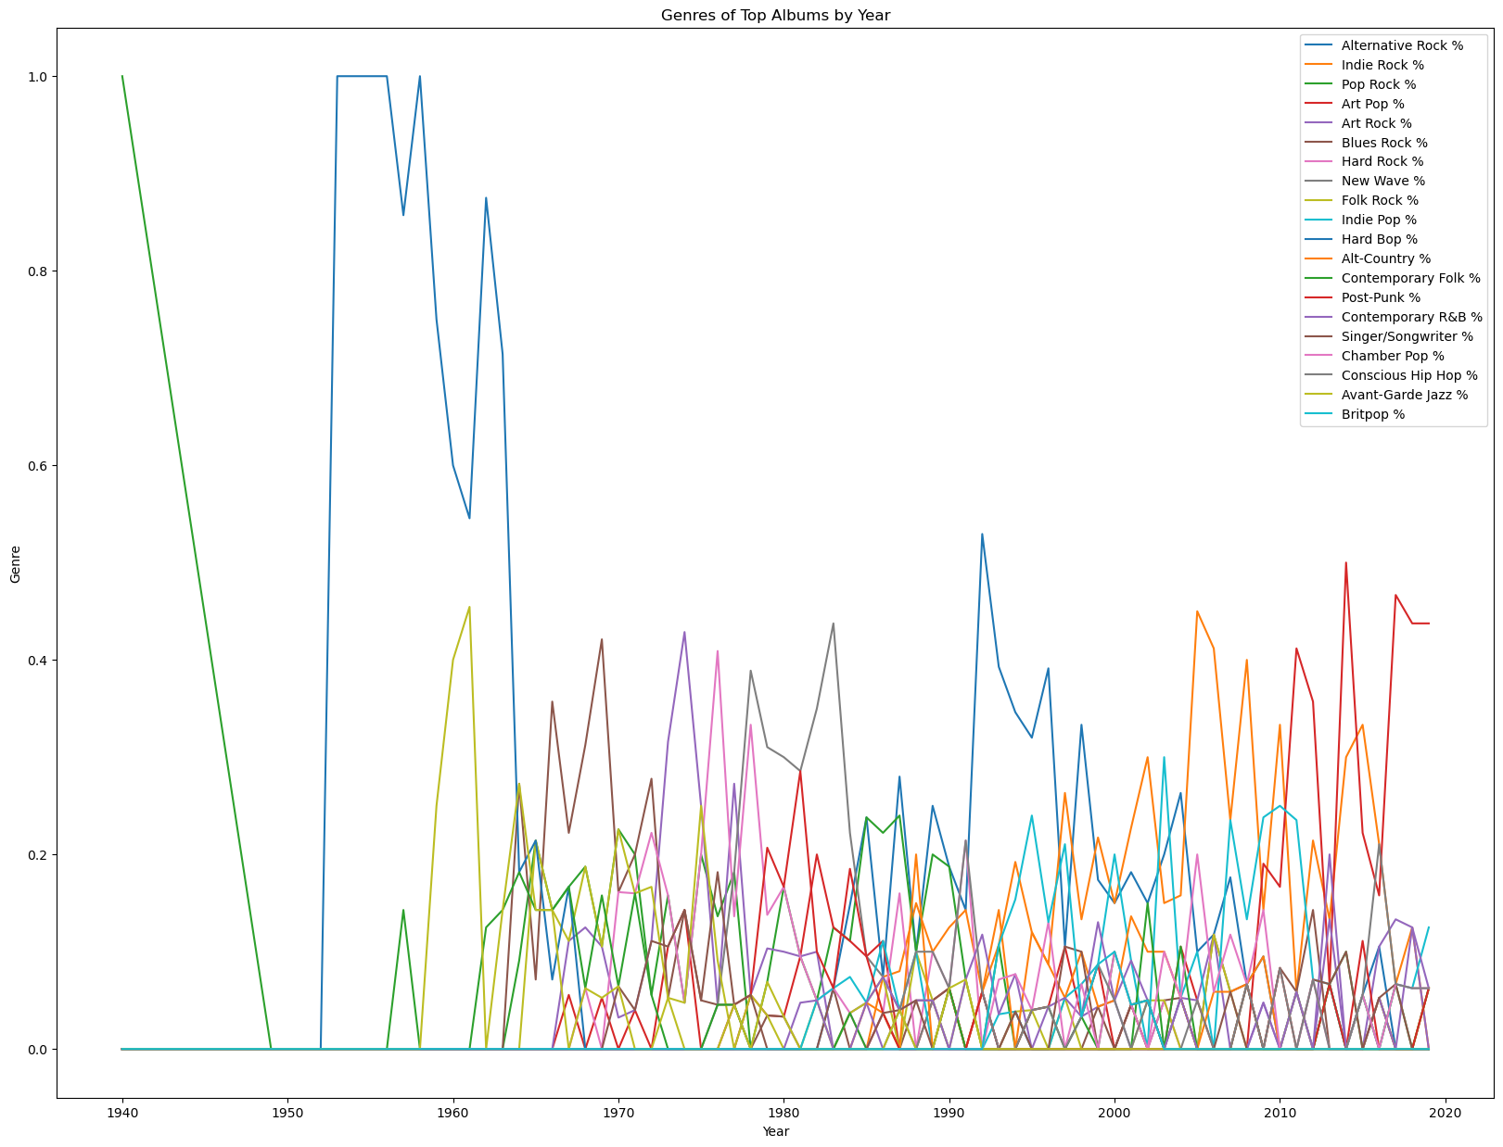
Graphs
Any Questions? LOL

Slide 6
Forecast Trends:
Forecast Trends, based on past and present data patterns.
Which Genres or artist are gaining traction?

Slide 7
Artist Discovery and Market Place
Market predictions
Algorithms have found their places in discovering emerging artists and predicting market trends within the music industry
By analysing data traits:
like listeners’
play count,
search popularity and
social media trends, platforms
like Soundcloud and
Next Big Sound provide predictive analytics signaling the next big hit or breakout artist.

Slide 8
Time Series Forecasting
Machine learning can also be utilized in predicting future music trends through Time Series Forecasting. This approach is particularly useful in predicting the popularity of new songs or predicting the rise or fall of a genre over time.

Slide 9
Sales Graph

